Slide 1
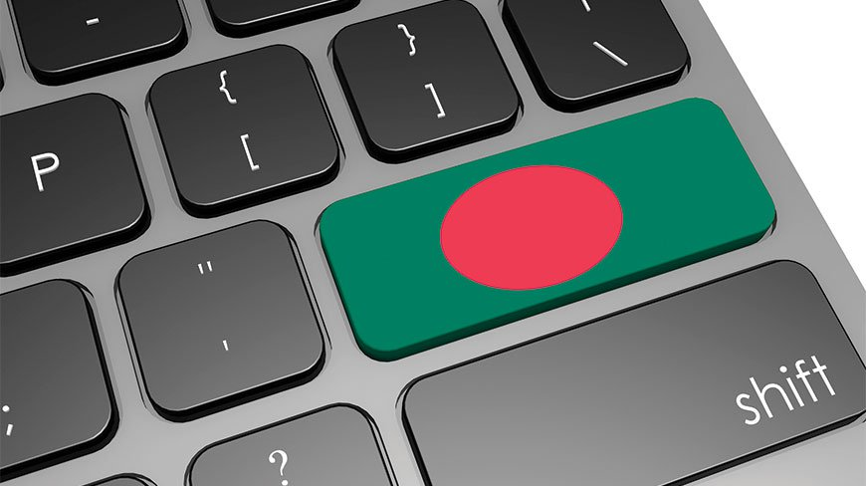
A Day in Bangladesh in 2050

Slide 2
Team Odyssey
Name | ID
Mahbuba Tasmin | 1610064042
MD. Townim Faisal | 1723127042
MD. Asif Iqbal Ahmed | 1811963642

Slide 3

Shakib Al Hasan
Bangladeshi Software Engineer
25 Years Old
Shakib is currently serving as a software engineer in one of the top software company(BD1971.co)around the globe from Bangladesh.

Slide 4
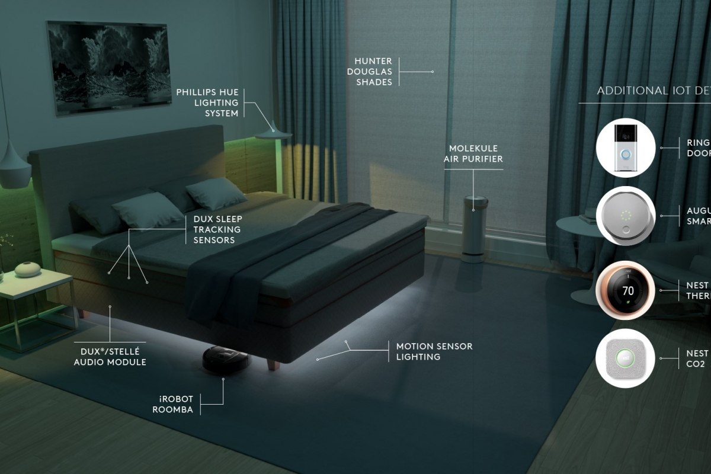
Let’s Take a Tour Around His Life

Slide 5
Shakib usually goes to sleep at 23:00, setting his Personal Wearable Bio Monitor at 7.00 in morning.
He checks the to-do lists for the next day in the holographic screen in the roof of his room before he finally falls asleep.
During the entire night, the PWBM monitors his sleep pattern, analyzes when is the best time to wake him up, considering he wants to wake up during a light sleep cycle while he is calm and rested.

Slide 6
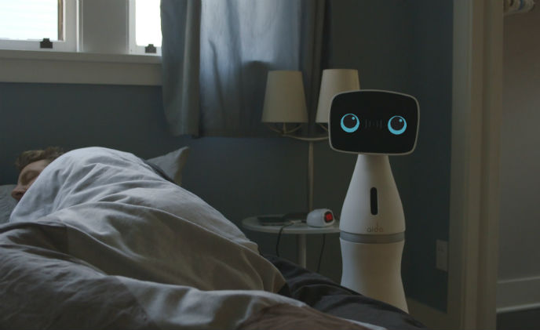
Morning Schedule
Before 7.00 clock, Shakib is
welcomed to the day by his
personal assistant bot, AIDO.
While he approaches towards the refreshing room, AIDO has already set the ambient temperature of shower and light intensity in accordance with the weather outside and Shakib’s preference, scraping the data from PWBM and its wireless capability.
AIDO has already ordered for a perfect cup of coffee for Shakib, displayed his newspaper on holographic screen and prepared the smart electric car for him to leave for his office.

Slide 7
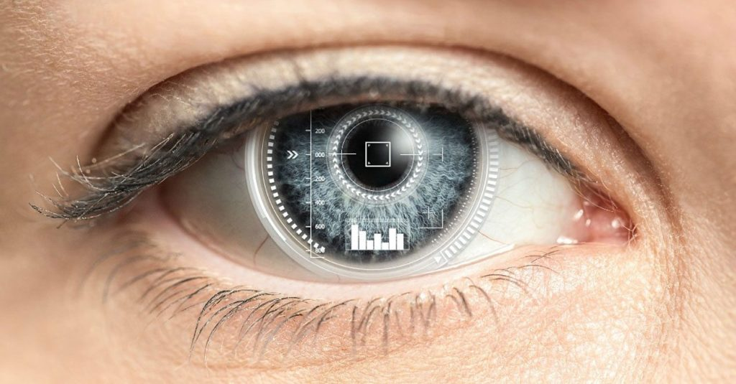
Vision Technology of 2050
Besides everything, Shakib loves his smart contact lenses. They replaced Google Glass ages ago.
These lenses are connected to his PWBM inside and they record everything Shakib sees.
This helps to get the information he needs and since the lenses update in real time, he rarely has any unanswered questions.

Slide 8
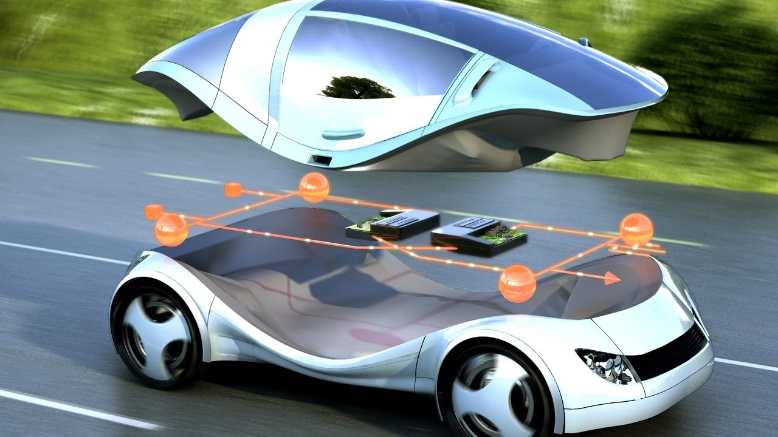
Commutation in 2050

Slide 9
Shakib leaves for his office, his self driven car is ready at the gate.
Since he still lives in a small growing technical city of Feni in Bangladesh, hence a small one-seat smart car is the perfect vehicle for traveling to work, which is only a few kilometers away.
On the weekends, Shakib and his family take their Electric Car, powered by real-time wireless electricity and devoid of batteries. Of course, all the cars in the streets of Bangladesh are now self-driven and the hectic rate of road accidents from 30 years back has drastically reduced to around 2%~3% from early 21st century.

Slide 10
Office Culture
Shakib enters into office at sharp 9 am. His virtual assistant Shishir tells him that she had a rough night sleeps.
Shakib pushes a button. It automatically configures his workstations, chair, light, desk according to his preference.
Shakib has many robot colleagues, sometimes he passes his free time to chat with them.

Slide 11
Office Culture
Shakib grabs a pizza at the 3D food vending machine.
At 3 pm, Shakib has a meeting with his clients. Shakib has 3D presenting his new software to the clients.
Shakib leaves office and takes a traffic free route which is calculated by his watch.

